Slide 1
Numerical Computation
Darrell Long
CSE 13S
Joseph-Louis Lagrange

Slide 2
Basic Arithmetic Operations
Computers can only do basic operations such as addition, subtraction, multiplication and division.
Multiplication is shift and addition,
Division is shift and subtraction,
Addition is little more than exclusive-xor
What about trigonometric functions?
Some processors do them internally, but they are still using the basic operations.
What about integrals? What about transforms? What about …?
These are in the realm of numerical methods.

Slide 3
Absolute Value
That’s an easy one: abs(x) = if x < 0 then –x else x
Should I just write the code?
It depends… Most mathematical libraries have families of absolute value functions that depend on the data type.
It may be faster to let the compiler or the mathematics library do it, since as in the case of floating point it may be just clearing a bit.

Slide 4
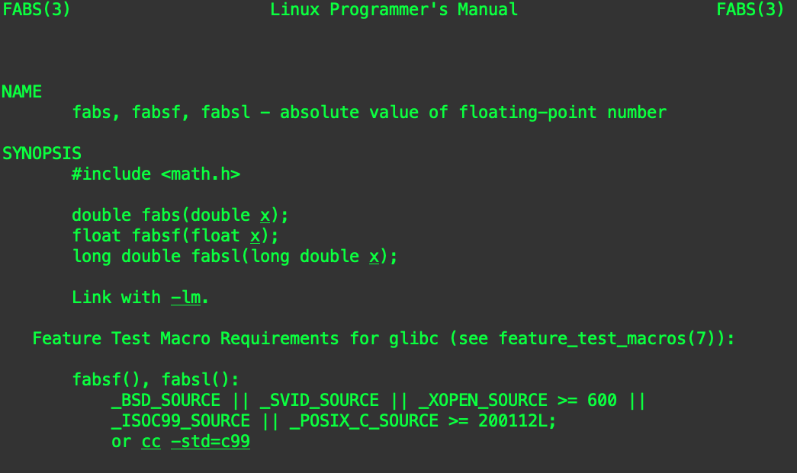
Check the man page!

Slide 5
Can I just use the library?
In general, yes, it is best to use the library.
The library should be designed to be:
Careful with numerical precision,
Fast, and portable.
That being said, it is important for you to have some understanding of what goes into implementing mathematical functions.
Remember: There is no magic!

Slide 6
Trigonometric Functions

Slide 7

Taylor Series
If $f(x)$ is a real or complex valued function, and it is infinitely differentiable then:
$f\left(x\right)=\sum_{n=0}^{∞}{\frac{f^{\left(n\right)}\left(a\right)}{n!} {(x−a)}^{n}}$
For example, consider $e^{x}$ centered at $a=0:$
$e^{x}=1+\frac{x}{1!}+\frac{x^{2}}{2!}+\frac{x^{3}}{3!}+…, −∞<x<∞$
Brook Taylor

Slide 8
Increasingly Better Approximations
Each derivative adds a term to the approximating polynomial.

Slide 9
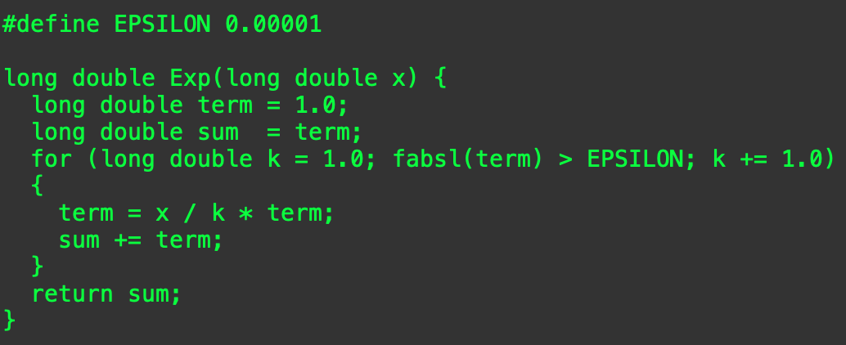


Computing $e^{x}$
$k!> x^{k}$ for all $x$, eventually (when $k$ gets large enough), so:
$\frac{x^{k}}{k!}$ gets smaller with each step (again, eventually)
We can stop when it gets small enough that it is “good enough” for our computation.

Slide 10


Computing $sin⁡(x)$
What do we know about $sin⁡(x)$?
It is:
Periodic on $[−2π, 2π]$, meaning that $\sin\left(9π\right)=\sin\left(π\right)$
Infinitely differentiable, making a good candidate for a Taylor series.
Where shall we center it? How about right in the middle, at zero:
$\sin\left(x\right)=x −\frac{x^{3}}{6}+\frac{x^{5}}{120}−\frac{x^{7}}{5040}+\frac{x^{9}}{362880}−\frac{x^{11}}{39916800}+O(x^{12})$
Is that good enough?
It depends on how close $x$ is to zero.
In general, you will need more terms.

Slide 11
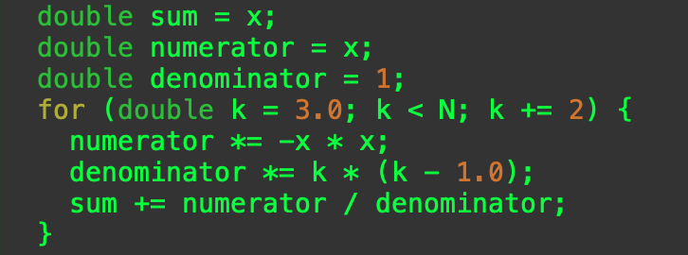

Computing the Terms
We skip even numbered terms, and
The sign of the terms alternate.
Before computing $sin⁡(x)$ do not forget to remove extra factors of $2π$.
How many terms do we need?

Slide 12
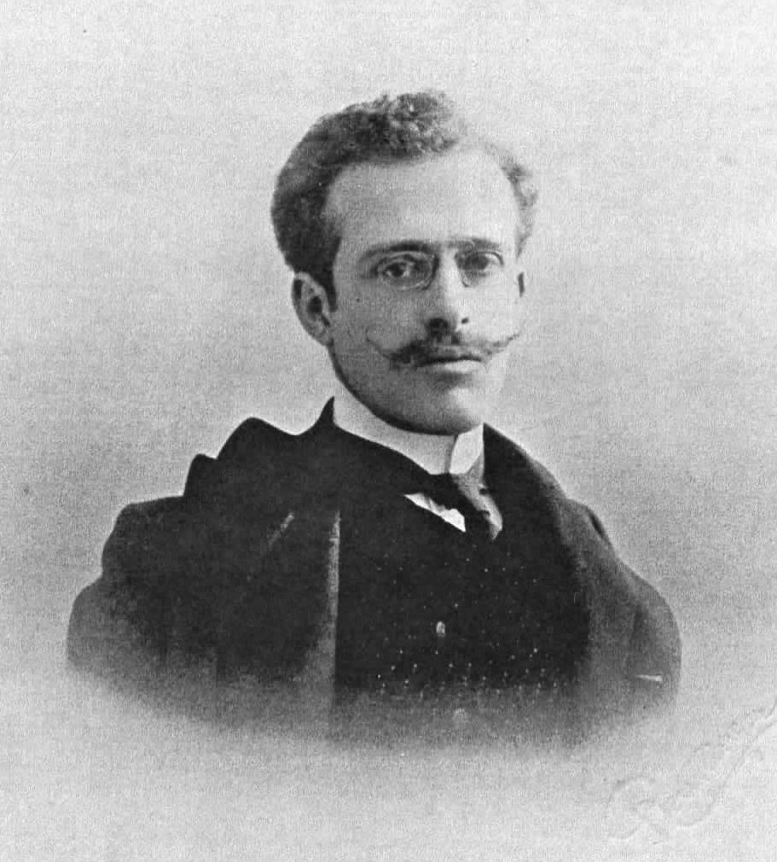

Padé Approximants
A Padé Approximant is the ratio of two polynomials that correspond to a series but is easier to compute and fit better around the center.
A $15$ term Taylor series results in the Padé approximant:
$p\left(x\right)=−72x (62077121x^{6}− 7479608290x^{4}+242757835320x^{2}−1727021696400)$
$q\left(x\right)=75x^{4}+5460x^{2}+166320$
$\sin\left(x\right)≈\frac{p\left(x\right)}{q\left(x\right)}$
How do I find them?
Take a course on numerical methods.
Look them up in old books.
Henri Padé

Slide 13
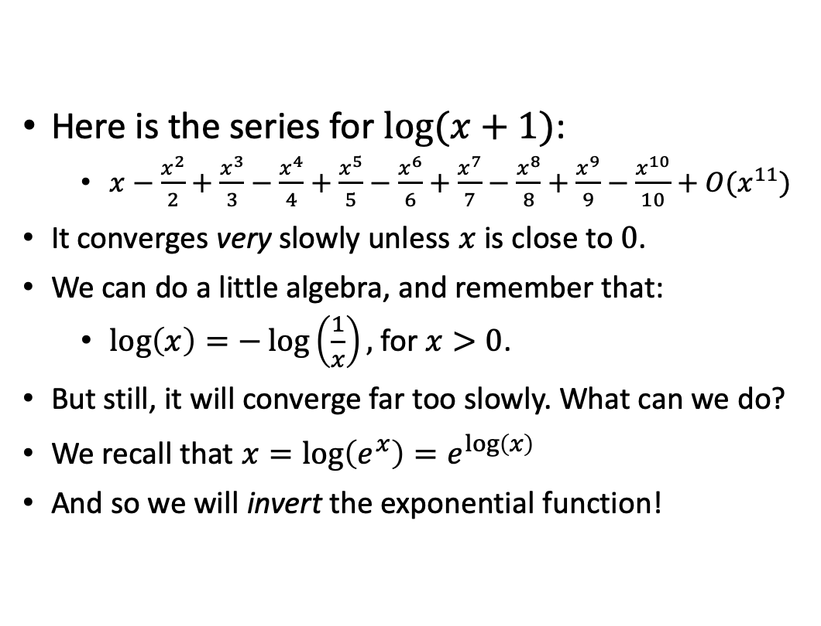
What happens if the series converges too slowly?
Here is the series for $log⁡(x+1)$:
$x−\frac{x^{2}}{2}+\frac{x^{3}}{3}−\frac{x^{4}}{4}+\frac{x^{5}}{5}−\frac{x^{6}}{6}+\frac{x^{7}}{7}−\frac{x^{8}}{8}+\frac{x^{9}}{9}−\frac{x^{10}}{10}+O(x^{11})$
It converges very slowly unless $x$ is close to $0$.
We can do a little algebra, and remember that:
$\log\left(x\right)=−\log\left(\frac{1}{x}\right),$for $x>0$.
But still, it will converge far too slowly. What can we do?
We recall that $x=\log\left(e^{x}\right)=e^{\log\left(x\right)}$
And so we will invert the exponential function!

Slide 14
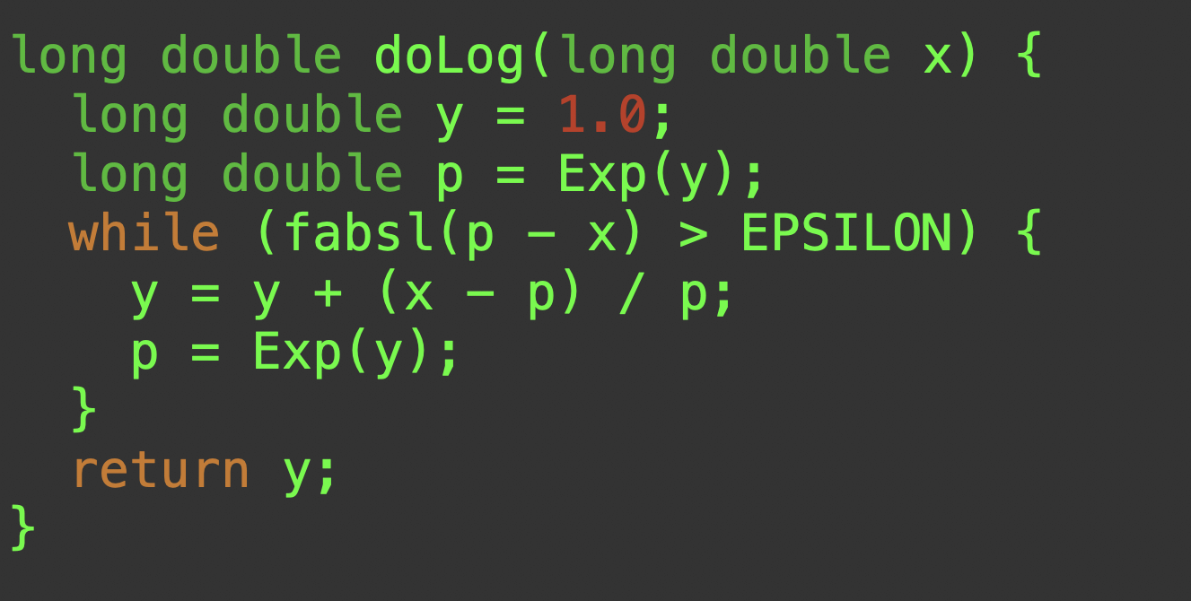


$log⁡(x)$ using Newton’s Method
Newton’s formula provides a linear approximation of the function.
Solve for $x_{n+1}$
$x_{n+1}=x_{n}+\frac{f\left(x_{n}\right)}{f^{′}\left(x_{n}\right)}$
Let $f\left(x\right)=x −e^{x}$
We iterate this equation until our answer is close enough:
$y_{n+1}=y_{n}+\frac{x−e^{y_{n}}}{e^{y_{n}}}$
For details, ask your calculus professor!
You can get very deep very quickly!

Slide 15
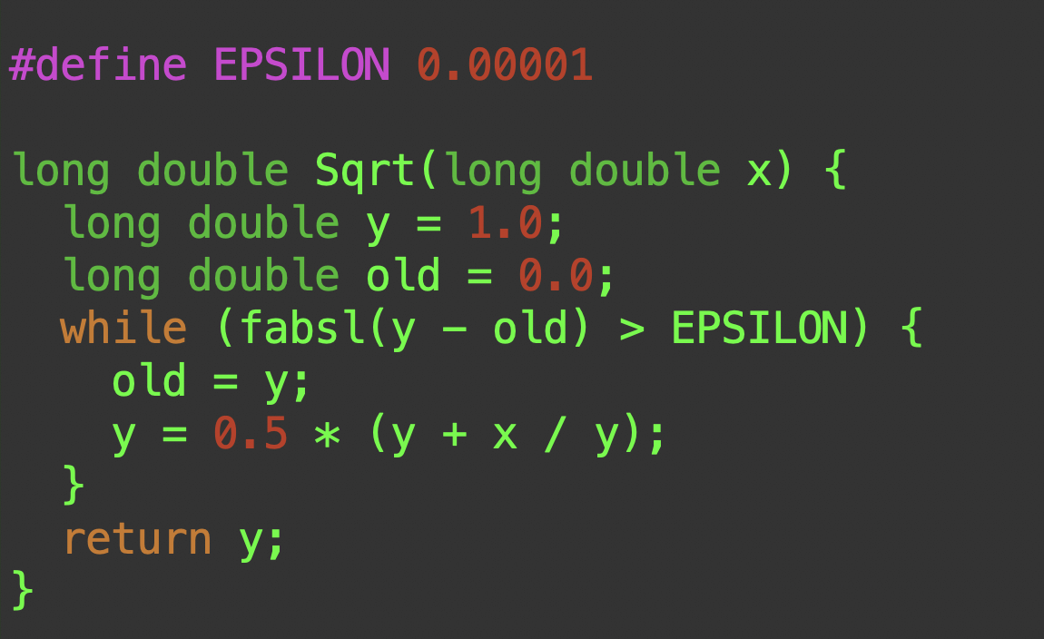
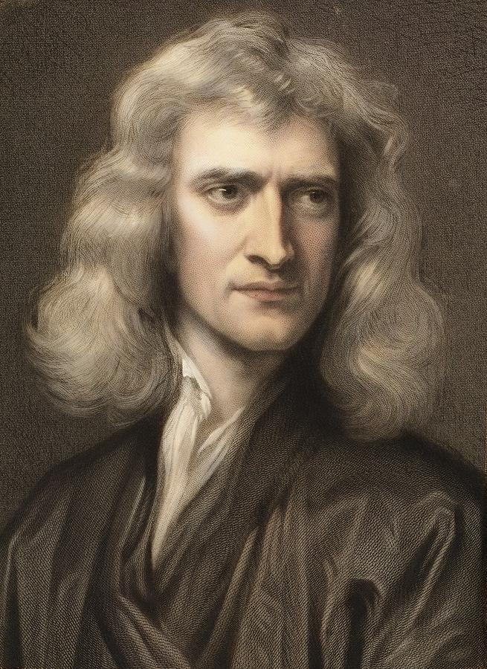


$\sqrt{n}$ using a Newton Iterate
Sir Isaac Newton comes to the rescue again.
We use this iterate:
$x_{k+1}=\frac{1}{2}(x_{k}+\frac{n}{x_{k}})$
As before, we iterate until the approximation is good enough.

Slide 16

What do we know?
Floating point numbers are not real numbers.
We need to take care when working with floating point numbers due to limited precision.
For example, subtracting two numbers of very different magnitudes can lose precision.
A Taylor series can approximate an infinitely differentiable function to arbitrary precision, but:
Often the series converges too slowly to be useful.

Slide 17

What should we do?
Use a good library when you can.
Be cognizant of the difference between floating point and real numbers.
Real numbers are all of the numbers, rational numbers are a subset of the reals, and floating point numbers are a subset of the rationals.
If you forget that they are different, you will get incorrect answers.
Understand that all of the special functions we have discussed are approximations.

